Slide 1
This presentation has been developed by IBAC for use by Victorian public sector organisations to inform their staff about Victoria’s public interest disclosure requirements.
January 2020

Slide 2

Corruption hurts everyone
Corruption in state government agencies and local government hurts the entire Victorian community.
If you have seen something that is not right in a Victorian government agency, local council or Victoria Police, you can safely, securely and anonymously report it.

Slide 3

^{Corruption erodes}
the community’s confidence and trust in the public sector.

Slide 4

Corruption affects:
Organisations: financial, reputational, staff morale, diversion of resources, loss of trust
Individuals: disciplinary action, termination, criminal charges, relationships
Communities: loss of public money, loss of public goods and services, loss of trust in public sector organisations.

Slide 5
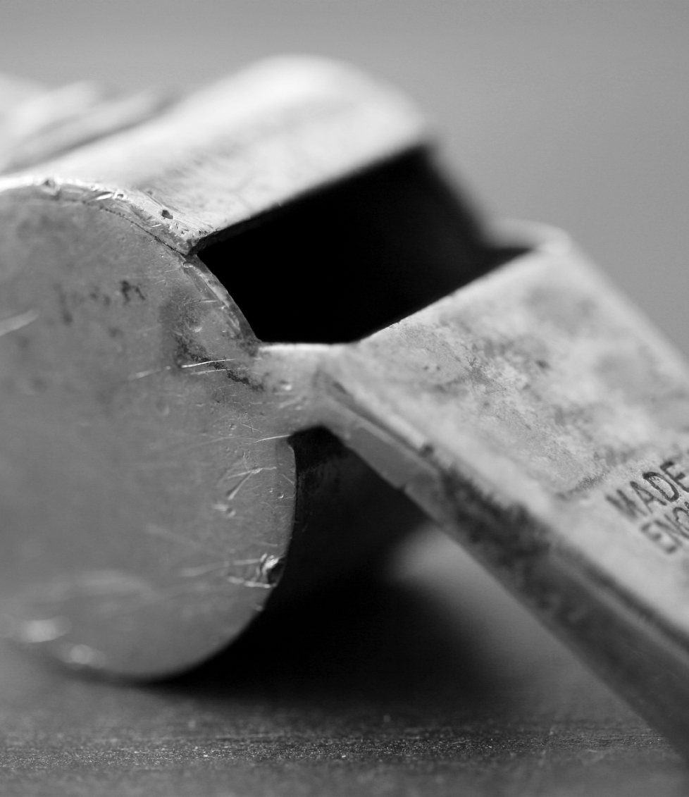
What is a public interest disclosure?
Commonly known as a whistleblower complaint.
The Public Interest Disclosures Act 2012 protects people who report improper conduct or detrimental action in the public sector (whistleblowers).
IBAC, the Victorian Inspectorate or the Integrity and Oversight Committee determine if what is reported is a public interest complaint.

Slide 6
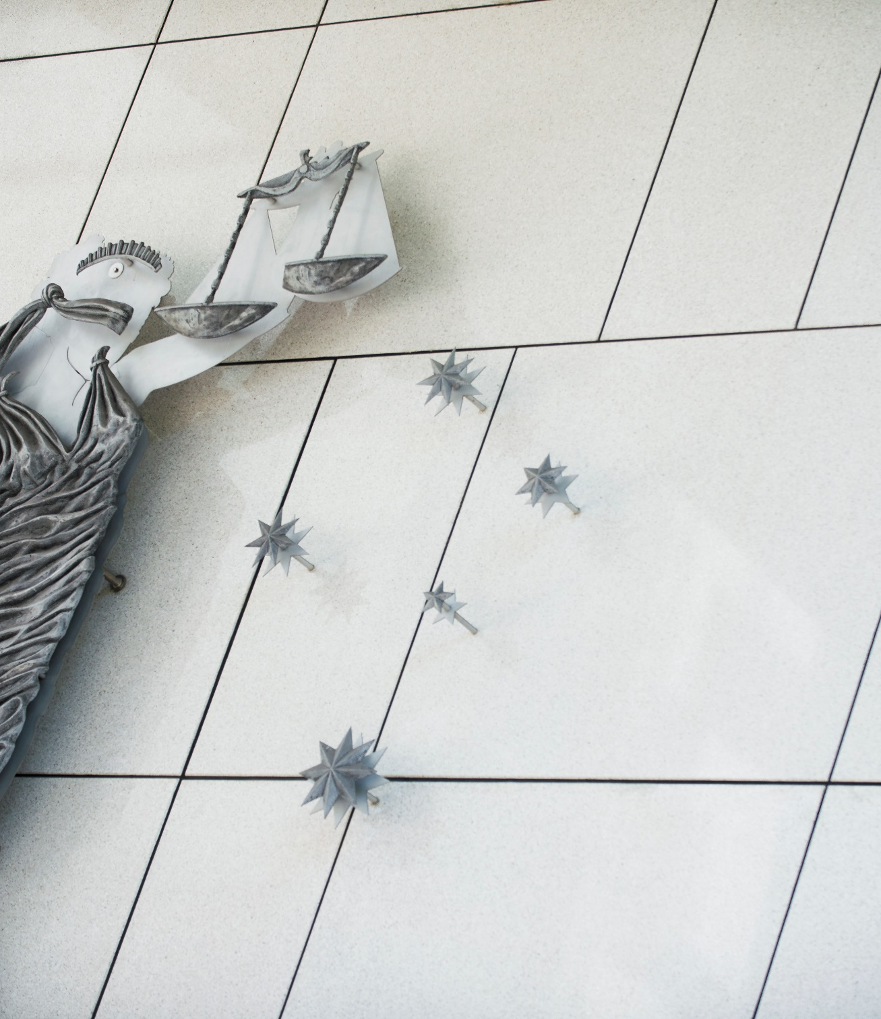
What qualifies as a public interest disclosure?
Must be about:
improper conduct by a public officer which includes criminal conduct, serious professional misconduct or conduct specified in the Act, or
detrimental action by a public officer, that might be harassment or discrimination, or other adverse action taken against a person in reprisal for having reported the alleged improper conduct.
Notes:
People seeking protection under the Act should carefully consider if their complaint meets these basic thresholds.

Slide 7



Examples of improper conduct
Committing fraud or theft
Taking or offering bribes
Employing or engaging friends or family as contractors
without proper process.
Awarding contracts to suppliers in return for personal benefit.
Unauthorised access and use of sensitive information for criminal or personal gain.
Use of government funds or property for personal benefit
Abuse of office or entitlements and allowances
Use of inside knowledge or influence for private gain

Slide 8
What is detrimental action?
Bullying or harassment at work after reporting alleged misconduct or corruption in the organisation.
Unfair dismissal due to reporting corruption or misconduct.
Being excluded from projects or work that would normally be assigned to you in reprisal.
Poor performance reviews in retaliation for reporting corruption and misconduct.
Legal action taken against you in reprisal for whistleblowing.

Slide 9

Protections may include:
keeping your identity confidential
protecting your welfare in
the workplace
protecting you from reprisals including bullying, harassment or even legal action.

Slide 10

How do I report improper conduct?
You can report improper conduct:
directly to IBAC
OR
to a public body’s Public Interest Disclosure Coordinator who will provide you with support, advice and welfare protections if you make a public interest disclosure*
*Some agencies cannot receive public interest disclosures under the Act. If this is the case the discloser should make their complaint directly to IBAC.
Notes:
Disclosures made to Public Interest Disclosure Coordinator’s must be assessed by the coordinator against the criteria of improper conduct/detrimental action and referred to IBAC, the Victorian Inspectorate or the Integrity and Oversight Committee where appropriate. IBAC’s website provides a list of public bodies that are authorised to receive disclosures.

Slide 11

Who investigates public interest complaints?
When IBAC receives a public interest disclosure it will either:
investigate it, or
refer it to a more appropriate body such as the Victorian Ombudsman, Victoria Police, the Victorian Inspectorate, the Chief Municipal Inspector or in some instances the Racing Integrity Commissioner of the Information Commissioner.
With the consent of the person who made the complaint, IBAC may also refer the complaint to another public entity to deal with.

Slide 12

Organisations must:
keep disclosures confidential
assess the risk of reprisal and protect a discloser from any adverse action as a result of making a disclosure
report disclosures to IBAC if the information shows improper conduct or detrimental action
report it to IBAC if it is suspected corrupt conduct
keep the discloser informed of the progress and the outcome.

Slide 13

Disclosures that are not usually considered improper conduct
Examples include:
Behaviour that does not meet standards of public sector employees such as rudeness towards customers or the public.
Minor breaches of HR policies and procedures.
Minor misconduct arising from employee conflict.

Slide 14
Before you report wrongdoing
Be informed and discreet.
Get information from IBAC or the Public Interest Disclosure Coordinator in your organisation.
Think about whether your complaint will meet the basic threshold of improper conduct or detrimental action.
Don’t tell others in the organisation that you are going to report the wrongdoing.
For more information you can contact IBAC on 1300 735 135
or make a report securely online at www.ibac.vic.gov.au

Slide 15
Notes:
Help prevent corruption
By reporting corruption you are helping your organisation to:
identify wrongdoing as soon as possible
avoid financial loss and inefficiency
maintain a good reputation, public trust and morale
ensure public funds are spent appropriately for the benefit of the community
improve accountability
deter employees from engaging in improper conduct.

